Slide 1
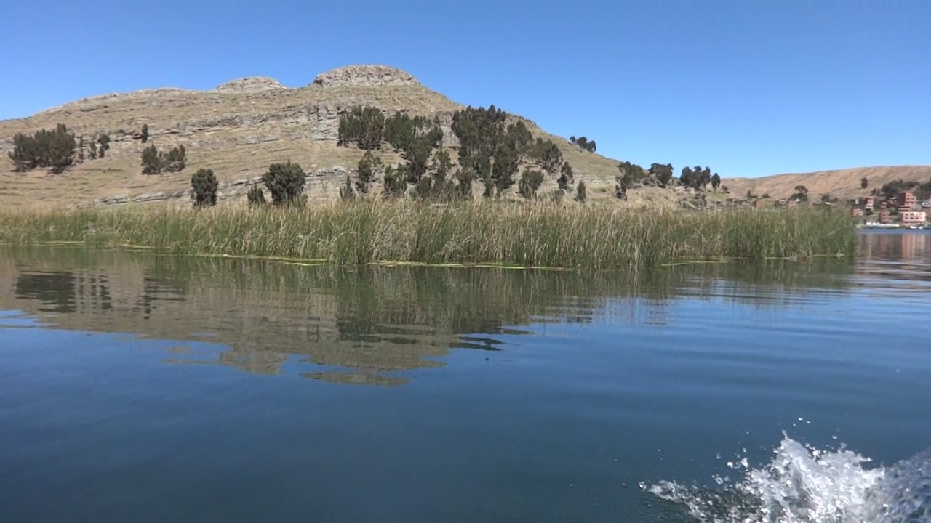
Water Supply and Treatment in Suriqui, Bolivia
juansemails: Helena Harris, Jennifer Jackson, John Sulich
Notes:
helena

Slide 2
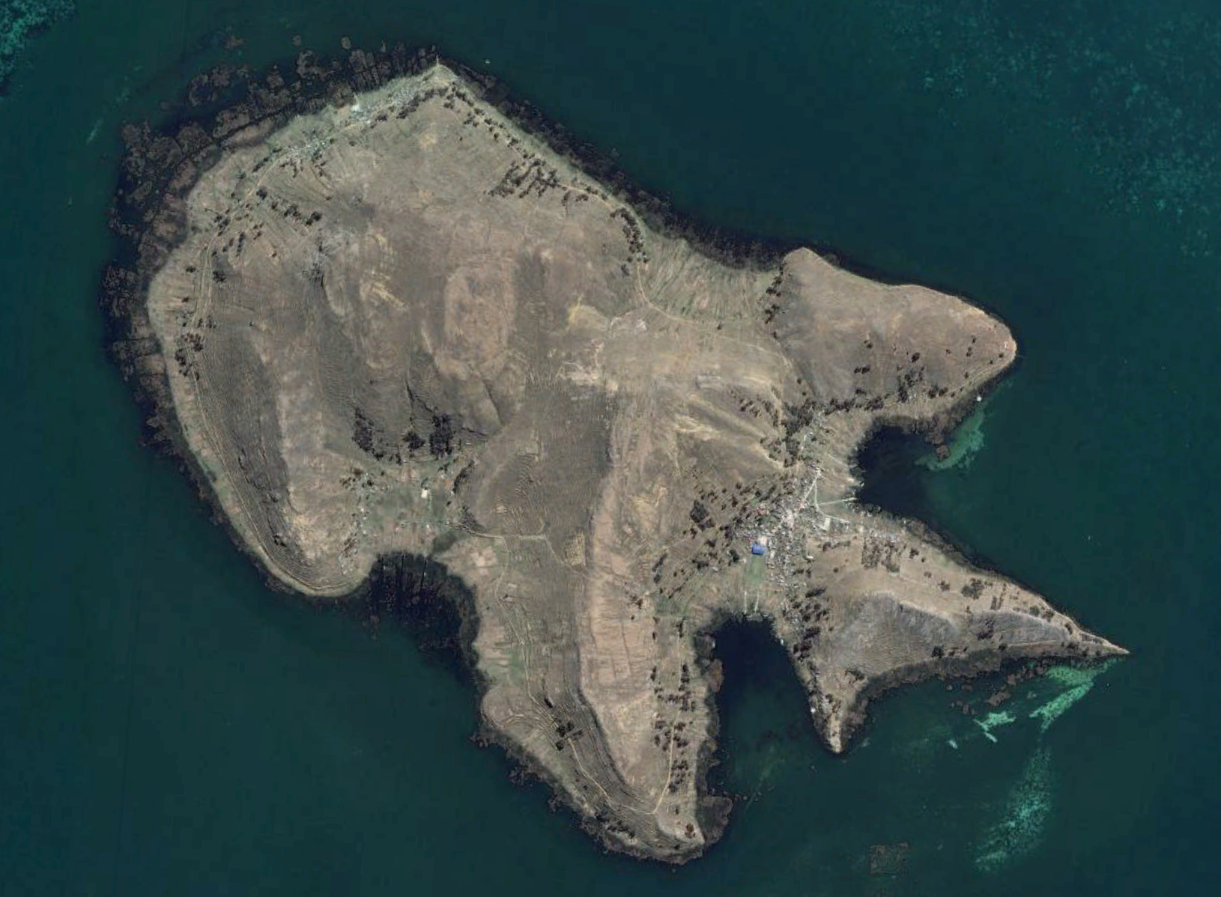
Our goal is to provide sustainable clean water to the Island of Suriqui
Bolivian Island in Lake Titicaca
Population of ~3,000
Rainy season – water from spring
Dry season – bottled water

Slide 3
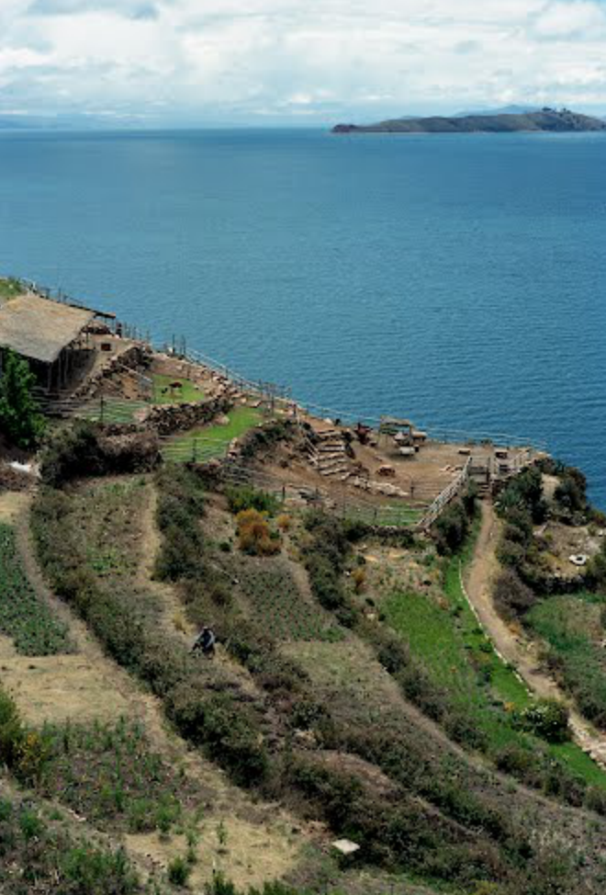
Secondary goal: To maximize upfront costs & minimize annual costs
Upfront costs ideally paid for by fund or donor
Annual costs fall to taxpayers
Siriqui inhabitants are not wealthy!

Slide 4
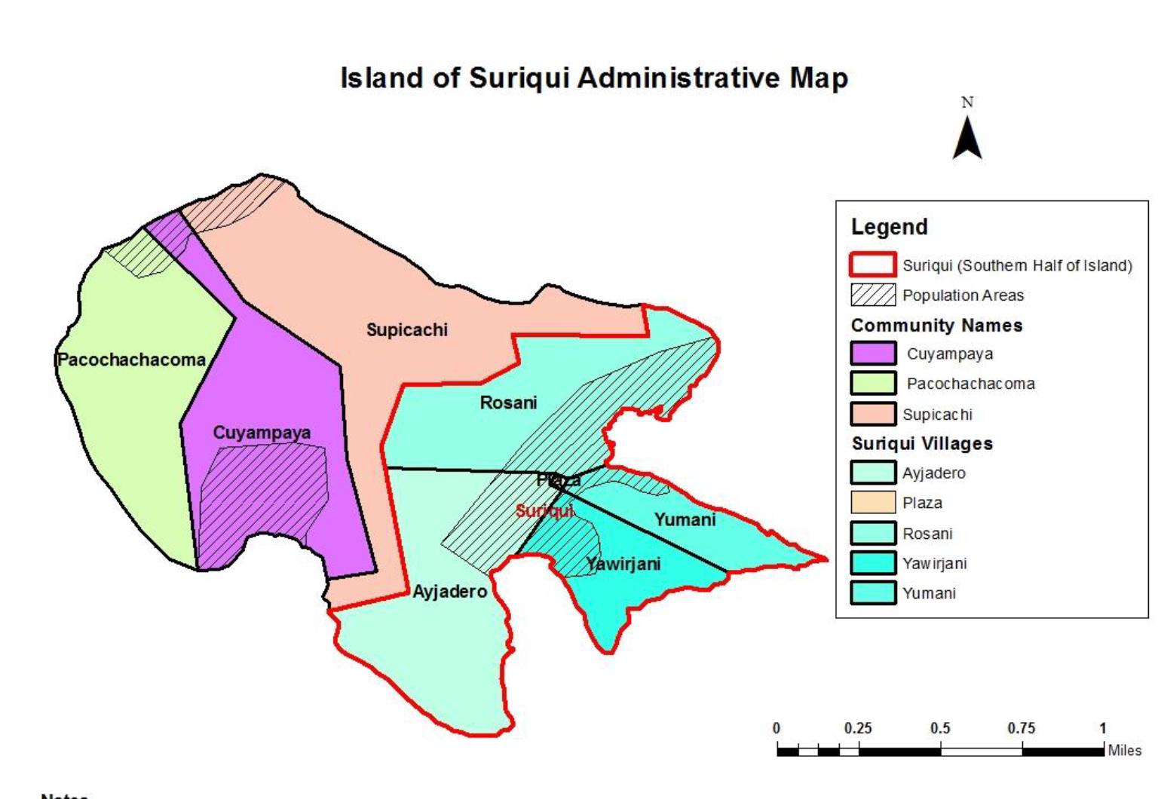
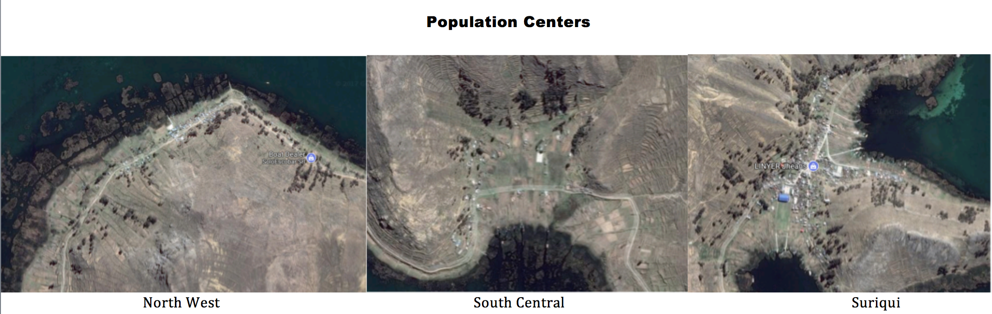
4 communities or 3 population centers?

Slide 5
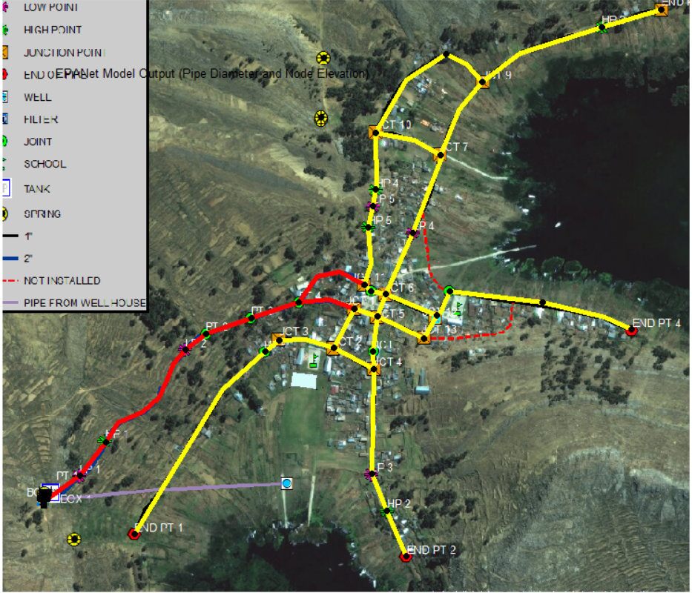
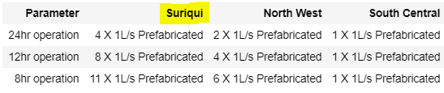
We chose multiple plants over a single plant
Avoid pumping water over long distances
Focus on design for main population center (Siriqui, pictured right)

Slide 6
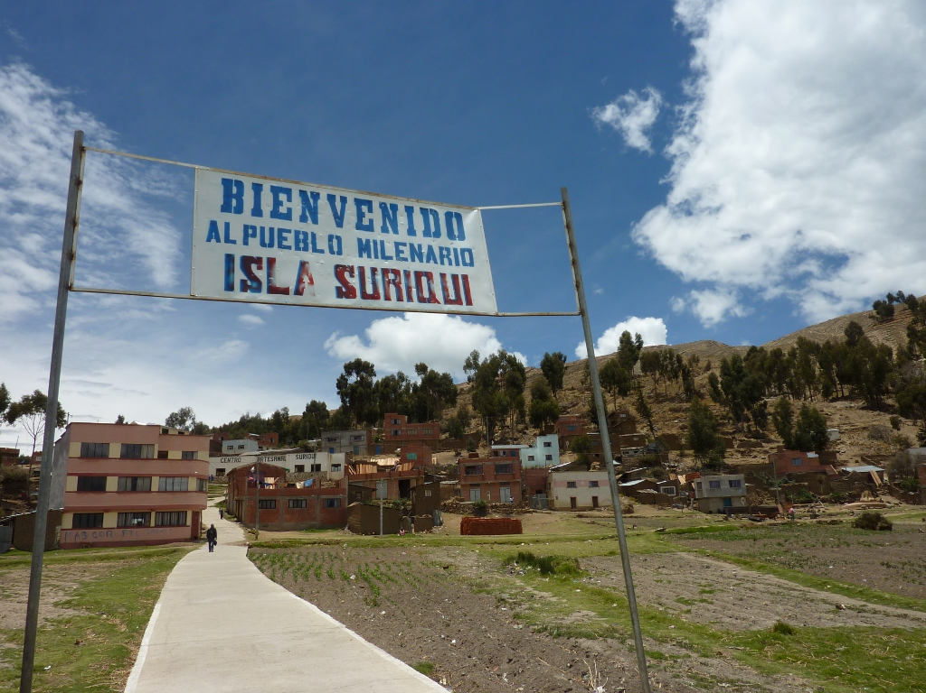
We chose the lake as our water source (This was a bad choice…. We’ll explain why at the end)
Well & spring don’t provide enough water
Well is not functional

Slide 7
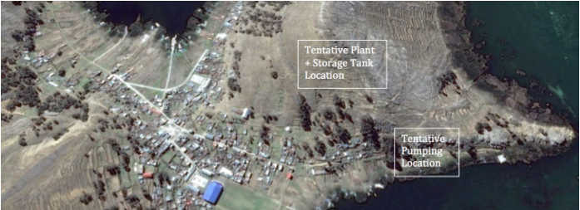
We located the plant at an elevation 10 m higher than the community
Notes:
helena

Slide 8
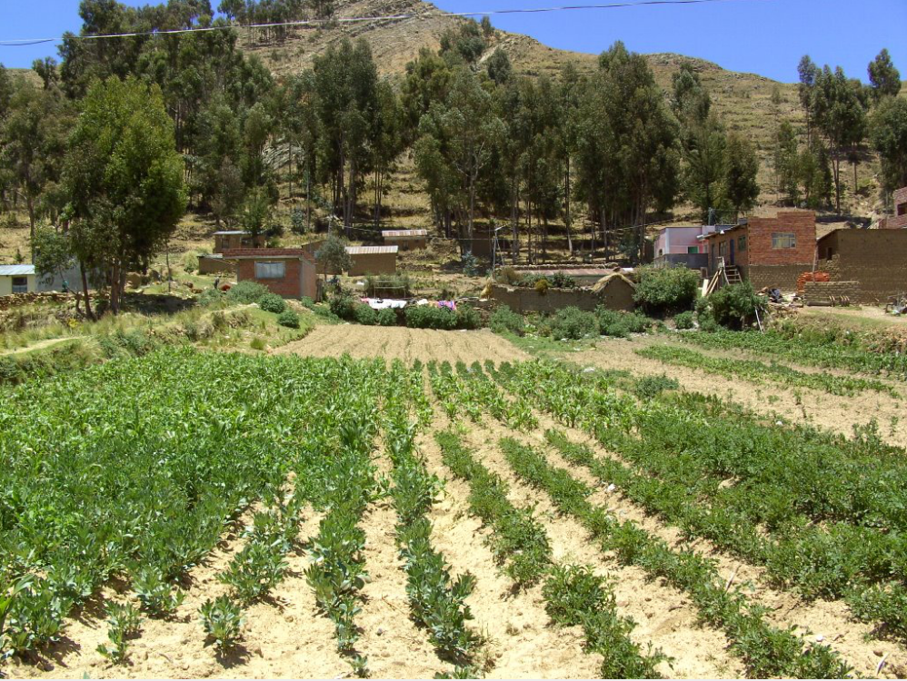
We chose to operate for 8 hours a day & store water
Higher upfront cost
(more plants + storage tank)
Lower annual cost
Notes:
John

Slide 9
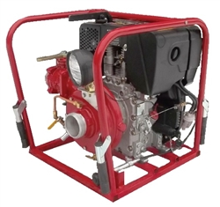
We chose a primed diesel pump to pump water from the lake to the plant
Island has very unreliable electricity
Notes:
john

Slide 10
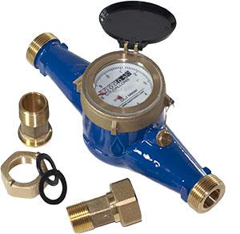
We chose to install water meters in each house
Rate cost
Cuts down on water use
Notes:
john

Slide 11
Key Constraints on our project:
Lake water – ideal source
Limited information on existing distribution systems
Unreliable electricity
Notes:
john

Slide 12
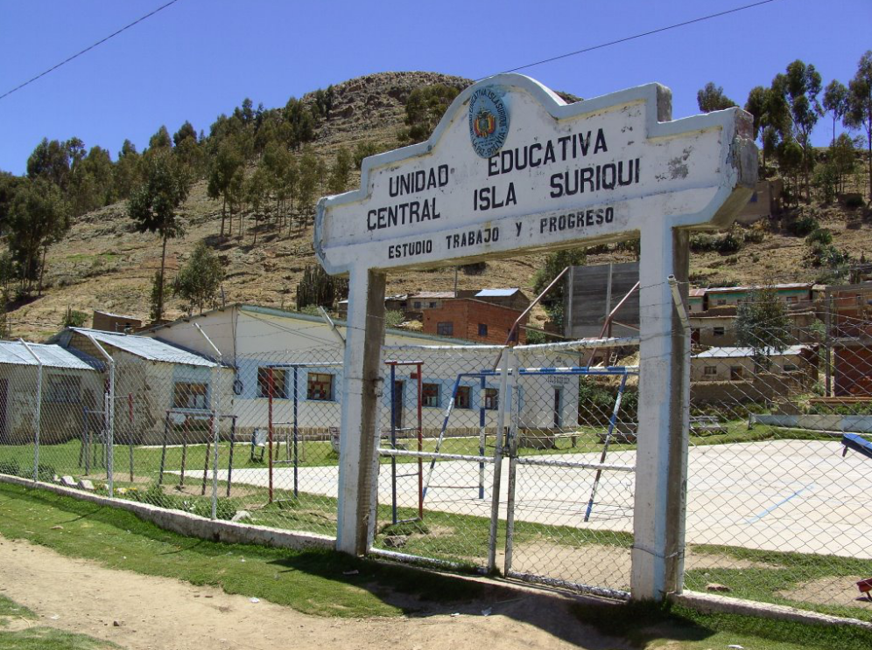
Trade-offs
Sustained low flow vs intermittent high flow
Operator wages vs. storage tank
Notes:
john

Slide 13
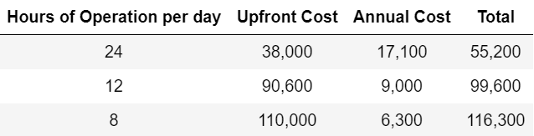
We calculated total upfront and annual costs (in $)
Notes:
Jennifer

Slide 14
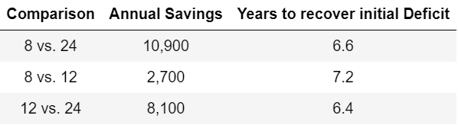
We found that the 8 hour plant would pay itself off relatively quickly
6.6 years to pay itself off
Ideal option
Notes:
Jennifer

Slide 15
Similar communities should look long term when picking water treatment options
More sustainable system implemented
Upfront cost can be funded by third party
Notes:
Jennifer

Slide 16
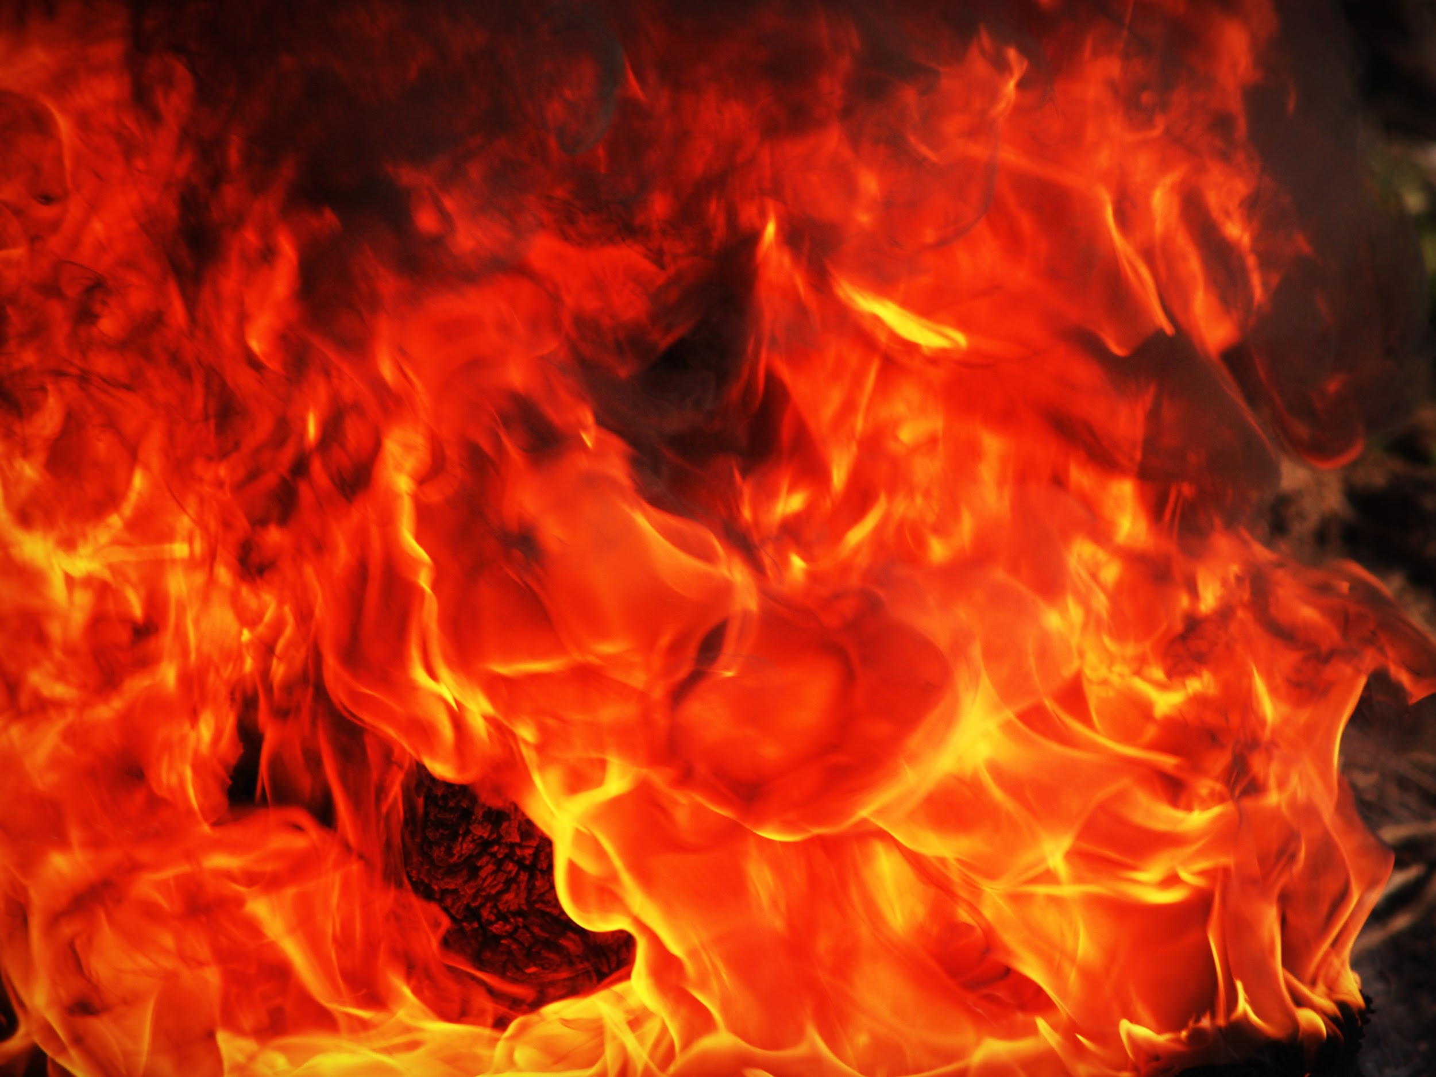
TWO DAYS AGO….
We found out that the lake water was too salty (like this guy’s tears) to be drinkable.
AguaClara cannot treat for this.
Notes:
Jennifer

Slide 17
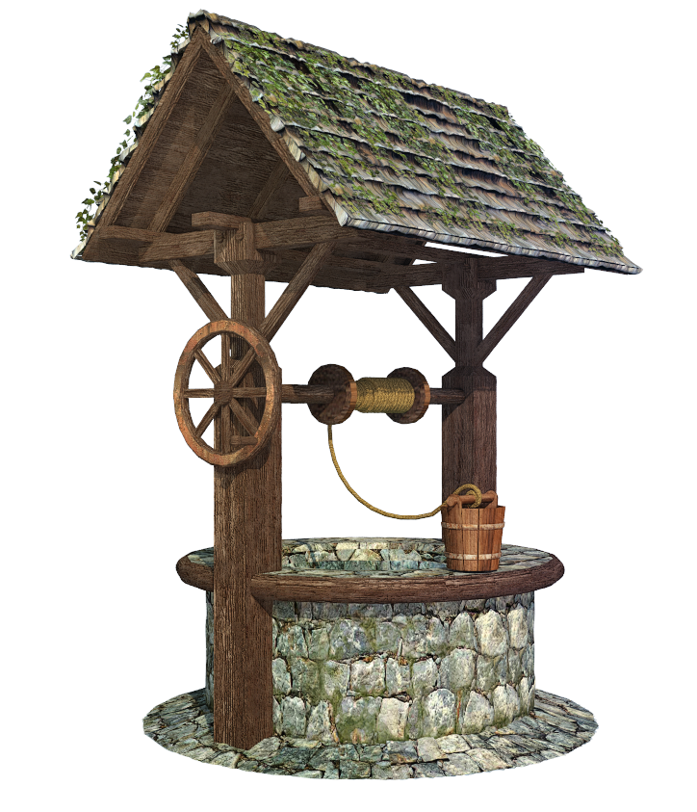
What likely will be done instead (according to David Buck at CH2M Hill):
Treat well water once existing well is fixed
Unknown flow capabilities of well:
Inhabitants may still need to import bottled water
Notes:
Jennifer

Slide 18

Acknowledgements
Professor Monroe
Juan
David Buck at CH2M

